Slide 2
Learn basics of Hadoop scheduler
Learn different types of Hadoop Scheduler
Learn failure scenario that can occur in Hadoop
Learn how to handle failure in mapreduce

Slide 3
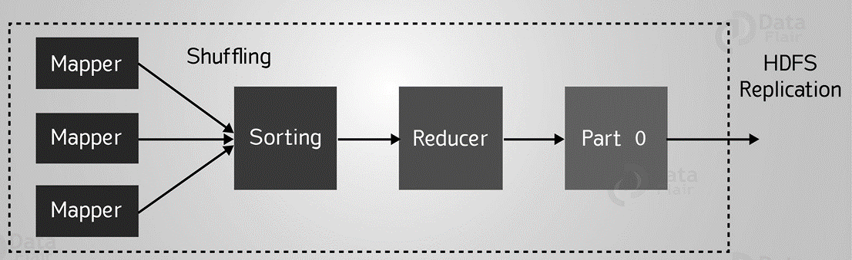
Introduction to Hadoop Scheduler

Slide 4
Introduction to Hadoop Scheduler
Hadoop MapReduce is responsible for :
scheduling tasks
monitoring them
re-executes the failed task.

Slide 5
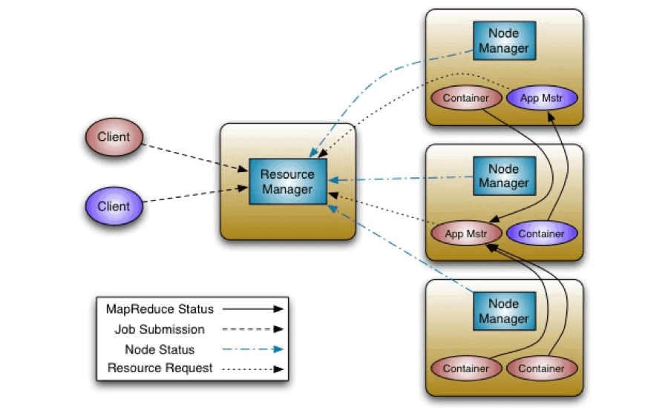
Introduction to Hadoop Scheduler

Slide 6
Introduction to Hadoop Scheduler
The ResourceManager has two main components that are
Schedulers
ApplicationsManager

Slide 7
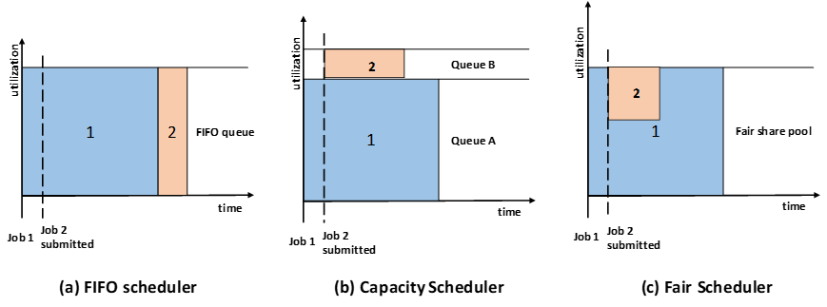
Types of HADOOP Scheduler

Slide 8
Types of HADOOP Scheduler
Fifo Scheduler

Slide 9
Advantages of FIFO Scheduling
It is simple to understand and doesn’t need any configuration.
Jobs are executed in the order of their submission.

Slide 10
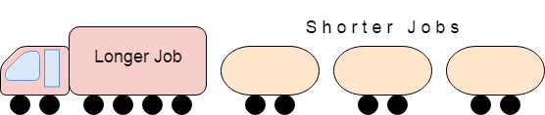
Disadvantages of FIFO Scheduling

Slide 11
Disadvantages of FIFO Scheduling
It is not suitable for shared clusters. If the large application comes before the shorter one, then the large application will use all the resources in the cluster, and the shorter application has to wait for its turn. This leads to starvation.
It does not take into account the balance of resource allocation between the long applications and short applications.

Slide 12
Types of HADOOP Scheduler
Capacity Scheduler

Slide 13
Capacity Scheduler
It allows multiple-tenants to securely share a large Hadoop cluster.
It is designed to run Hadoop applications in a shared, multi-tenant cluster.
It supports hierarchical queues to reflect the structure of organizations.

Slide 14
Capacity Scheduler
root
A queue hierarchy contains three types of queues that are
parent
and leaf.

Slide 15

Capacity Scheduler
To ensure fairness and stability, it also provides limits on initialized and pending apps from a single user and queue.

Slide 16
Advantages of Capacity Scheduler
It maximizes the utilization of resources and throughput in the Hadoop cluster.
Provides elasticity for groups or organizations in a cost-effective manner.
It also gives capacity guarantees and safeguards to the organization utilizing cluster.

Slide 17
Disadvantages of Capacity Scheduler
It is complex amongst the other scheduler.

Slide 18
Types of HADOOP Scheduler
Fair Scheduler

Slide 19
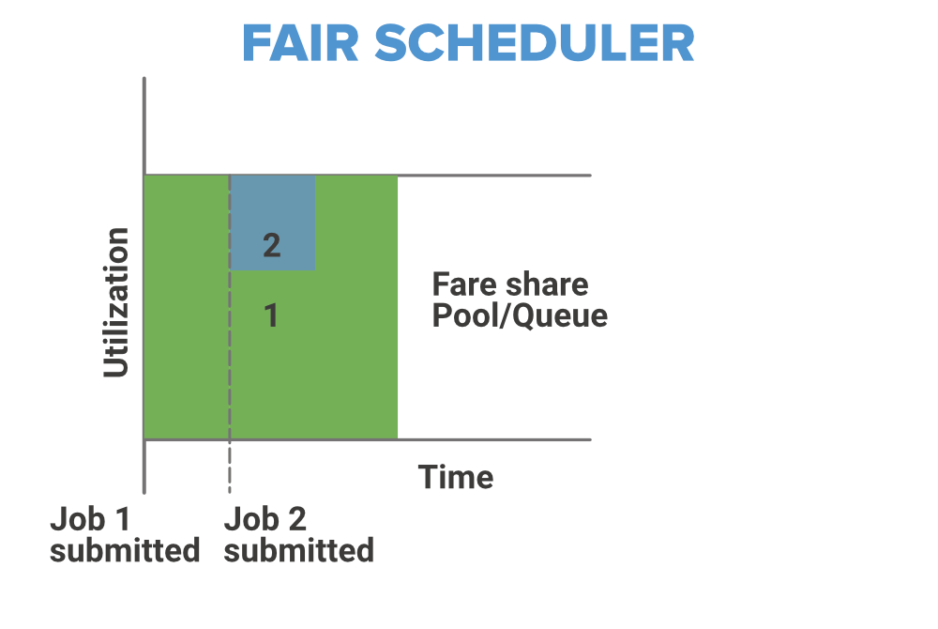
Types of HADOOP Scheduler

Slide 20
Advantages of Fair scheduler
It provides a reasonable way to share the Hadoop Cluster between the number of users.
Also, the Fair Scheduler can work with app priorities where the priorities are used as weights in determining the fraction of the total resources that each application should get.

Slide 21
Disadvantages of Fair scheduler
It requires configuration.

Slide 22
Failures in MapReduce
In classic MapReduce, there can be three kinds of failures
  Failure of map reduce task
  Failure of task tacker
  Failure of Job Tracker

Slide 23
Failures in Classic Map-reduce
Job Tracker
Job Tracker Node
Heart Beats
Task Tracker
Step 3
Child JVM
Map or reduce Task

Slide 24
Failures in Classic Map-reduce
Job Tracker
Job Tracker Node
Heart Beats
Task Tracker
Step 3
Child JVM
Map or reduce Task

Slide 25
Failures in Classic Map-reduce
Job Tracker
Job Tracker Node
Heart Beats
Task Tracker
Step 3
Child JVM
Map or reduce Task

Slide 26
Failures in Classic Map-reduce
Job Tracker
Job Tracker Node
Heart Beats
Task Tracker
Step 3
Child JVM
Map or reduce Task

Slide 27
Failures in Classic Map-reduce
Job Tracker
Job Tracker Node
Heart Beats
Task Failure
Code Caused Issues
Task Tracker
Step 3
Child JVM
Map or reduce Task

Slide 28
Failures in Classic Map-reduce
Job Tracker
Job Tracker Node
Heart Beats
Task Failure
Code Caused Issues
Infinite Loop/Hung Code
Task Tracker
Step 3
Child JVM
Map or reduce Task

Slide 29
Failures in Classic Map-reduce
Job Tracker
Job Tracker Node
Heart Beats
Task Failure
Code Caused Issues
Infinite Loop/Hung Code
mapred.task.timeout=0
Task Tracker
Step 3
Child JVM
Map or reduce Task

Slide 30
Failures in Classic Map-reduce
Job Tracker
Job Tracker Node
Heart Beats
Task Failure
Code Caused Issues
Infinite Loop/Hung Code
mapred.task.timeout=0
Run time error
Task Tracker
Step 3
Child JVM
Map or reduce Task

Slide 31
Failures in Classic Map-reduce
Job Tracker
Job Tracker Node
Heart Beats
Task Tracker
User Logs
Report Error
Child JVM
Map or reduce Task

Slide 32
Failures in Classic Map-reduce
Job Tracker
Job Tracker Node
Heart Beats
Task Failure
JVM ERRORS
Task Tracker
User Logs
Report Error
Child JVM
Map or reduce Task

Slide 33
Failures in Classic Map-reduce
Job Tracker
Job Tracker Node
Heart Beats
Task Tracker
Task Tracker
User Logs
Report Error
Report Error
Child JVM
Child JVM
And job tracker reschedules the execution of the failed task on a different task tracker.
Map or reduce Task
Map or reduce Task

Slide 34
Failures in Classic Map-reduce
Job Tracker
Job Tracker Node
Heart Beats
Task Tracker
Task Tracker
User Logs
Report Error
Report Error
Child JVM
Child JVM
“mapred.map.max.attempts”=4 (default)
Map or reduce Task
Map or reduce Task

Slide 35
Failures in Classic Map-reduce
Job Tracker
Job Tracker Node
Heart Beats
Task Tracker
Task Tracker
User Logs
Report Error
Report Error
Child JVM
Child JVM
“mapred.map.max.attempts”=4 (default)
Map or reduce Task
Map or reduce Task
“mapred.reduce.max.attempts”=4 (default)

Slide 36
Failure of TaskTracker

Slide 37
Failure of TaskTracker
Job Tracker
Job Tracker Node
Heart Beats
Task Tracker
Step 3
Child JVM
Map or reduce Task

Slide 38
Failure of TaskTracker
Job Tracker
Job Tracker Node
Heart Beats
Task Tracker
Step 3
Child JVM
Map or reduce Task

Slide 39
Failure of TaskTracker
Job Tracker
Job Tracker Node
Heart Beats
Task Tracker
Task Tracker
Step 3
Step 3
Reschedules the task on other task tracker.
Child JVM
Child JVM
Map or reduce Task
Map or reduce Task

Slide 40
Failure of TaskTracker
Job Tracker
Job Tracker Node
Heart Beats
Task Tracker
Task Tracker
Step 3
Step 3
mapred.max.tracker.failures
Child JVM
Child JVM
Map or reduce Task
Map or reduce Task

Slide 41
Failure of Job Tracker

Slide 42
Failures of JobTracker
Job Tracker
Job Tracker Node
Heart Beats
Task Tracker
Step 3
Child JVM
Map or reduce Task

Slide 43
Failures of JobTracker
Job Tracker
Job Tracker Node
Heart Beats
Task Tracker
Single Point of Failure
Step 3
Child JVM
Map or reduce Task

Slide 44
Failures in Yarn

Slide 45
Failures in Yarn
It can following failure scenarios in YARN framework.
Task failure
Application master failure
Node Manager Failure
And last is resource manager failure

Slide 46
Failure Scenarios in YARN
MapReduce Program
Job Client
Resource manager
Client JVM
Client Mode
Heartbeats
Heartbeats
Node Manager
Node Manager
Task JVM
Child JVM
YARN Child
App Master
Map or Reduce Tasks
Node Manager Node

Slide 47
Failure Scenarios in YARN
MapReduce Program
Job Client
Resource manager
Client JVM
Client Mode
Heartbeats
Heartbeats
Node Manager
Node Manager
Task JVM
Child JVM
YARN Child
App Master
Map or Reduce Tasks
Node Manager Node

Slide 48
Failure Scenarios in YARN
MapReduce Program
Job Client
Resource manager
Client JVM
Client Mode
Heartbeats
Heartbeats
Node Manager
Node Manager
Task JVM
Child JVM
YARN Child
App Master
Map or Reduce Tasks
Node Manager Node

Slide 49
Failure Scenarios in YARN
MapReduce Program
Job Client
Resource manager
Client JVM
Client Mode
Heartbeats
Heartbeats
Node Manager
Node Manager
Task JVM
Child JVM
YARN Child
App Master
Map or Reduce Tasks
Node Manager Node

Slide 50
Failure Scenarios in YARN
MapReduce Program
Job Client
Resource manager
Client JVM
Client Mode
Heartbeats
Heartbeats
Node Manager
Node Manager
Task JVM
Child JVM
YARN Child
App Master
Map or Reduce Tasks
Node Manager Node

Slide 51
Task failure
Runtime exceptions and sudden exits of the JVM are propagated
Node Manager
Task JVM
YARN Child
Map or Reduce Tasks

Slide 52
Task failure
Runtime exceptions and sudden exits of the JVM are propagated
Hanging tasks are noticed by the application master
Node Manager
Task JVM
YARN Child
Map or Reduce Tasks

Slide 53
Task failure
Runtime exceptions and sudden exits of the JVM are propagated
Hanging tasks are noticed by the application master
mapreduce.task.time out
Node Manager
Task JVM
YARN Child
Map or Reduce Tasks

Slide 54
Task failure
Runtime exceptions and sudden exits of the JVM are propagated
Hanging tasks are noticed by the application master
mapreduce.task.time out
The configuration properties for determining when a task is considered to be failed are the same as the classic case.
Node Manager
Task JVM
YARN Child
Map or Reduce Tasks

Slide 55
Task failure
mapreduce.map.maxattempts
Node Manager
Task JVM
YARN Child
Map or Reduce Tasks

Slide 56
Task failure
mapreduce.map.maxattempts
mapreduce.reduce.maxattempts.
Node Manager
Task JVM
YARN Child
Map or Reduce Tasks

Slide 57
Task failure
mapreduce.map.maxattempts
mapreduce.reduce.maxattempts.
mapreduce.map.failures.maxpercent
Node Manager
Task JVM
YARN Child
Map or Reduce Tasks

Slide 58
Task failure
mapreduce.map.maxattempts
mapreduce.reduce.maxattempts.
mapreduce.map.failures.maxpercent
mapreduce.reduce.failures.maxpercent
Node Manager
Task JVM
YARN Child
Map or Reduce Tasks

Slide 59
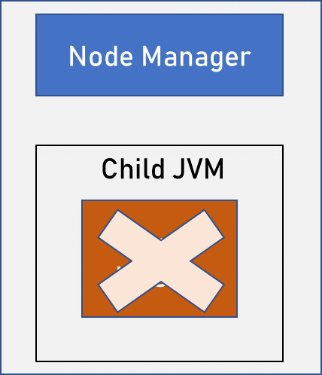
Application Master Failure
Applications in YARN are tried multiple times in the event of failure.
yarn.resourcemanager.am.max-retries.
An application master sends periodic heartbeats to the resource manager

Slide 60
Application Master Failure
It can recover the state of the tasks that had already been run by the (failed) application.
yarn.app.mapreduce.am.job.recov ery.enable

Slide 61
Application Master Failure
The client polls the application master for progress reports
it doesn’t overload the the resource manager with a request every time it needs to poll the application master.
If the application master fails, however, the client will experience a timeout when it issues a status update

Slide 62
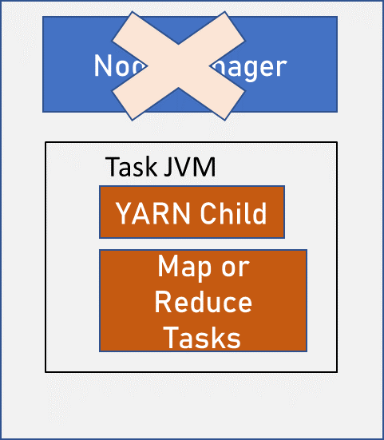
Node Manager Failure
If a node manager fails, then it will stop sending heartbeats to the resource manager
yarn.resourcemanager.nm.liveness-monitor.expiry-intervalms
Node managers may be blacklisted if the number of failures for the application is high.

Slide 63
Node Manager Failure
Blacklisting is done by the application master
mapreduce.job.maxtaskfai lures.per.tracker.

Slide 64
Resource Manager Failure
Failure of the resource manager is serious
Resource manager

Slide 65
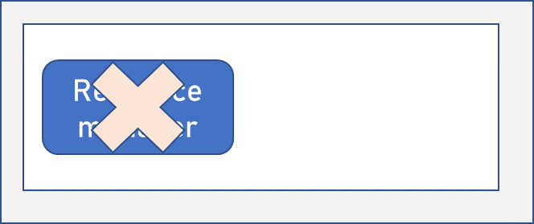
Resource Manager Failure
After a crash, a new resource manager instance is brought up (by an adminstrator) and it recovers from the saved state.
The state consists of the node managers in the system as well as the running applications.

Slide 66
Resource Manager Failure
yarn.resourceman ager.store.class
org.apache.hadoop.yarn.server.resource manager.recovery.MemStore

